Slide 1
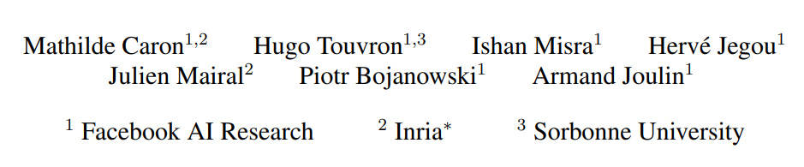
DINO: Emerging Properties in Self-Supervised Vision Transformers
ICCV(2021), 3060 citation

Slide 2
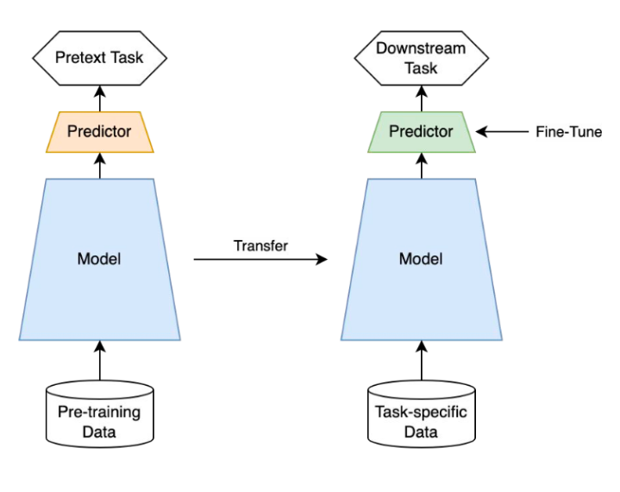
Self-Supervised Learning
Objective
When labeled data is insufficient, use it
Get a good representation and apply it to the downstream task (representation learning)

Slide 3
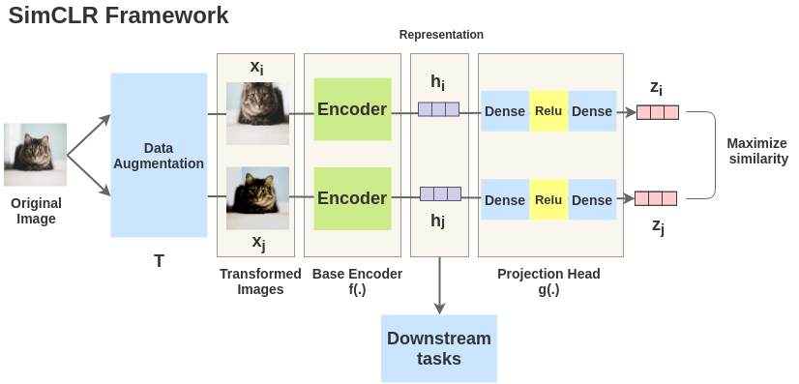
Background: SimCLR
Contrastive learning
Data augmentation

Slide 4
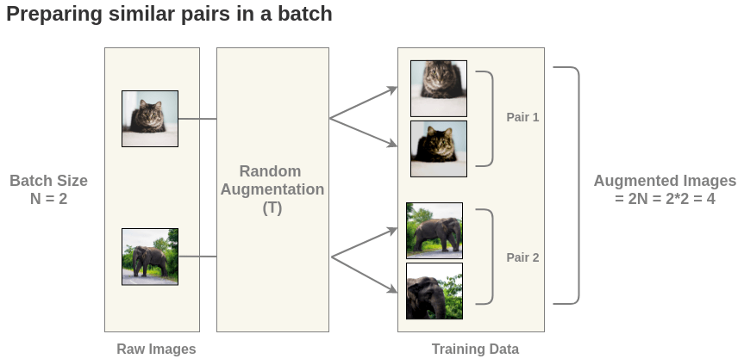
Background: SimCLR
Contrastive learning
Data augmentation

Slide 5
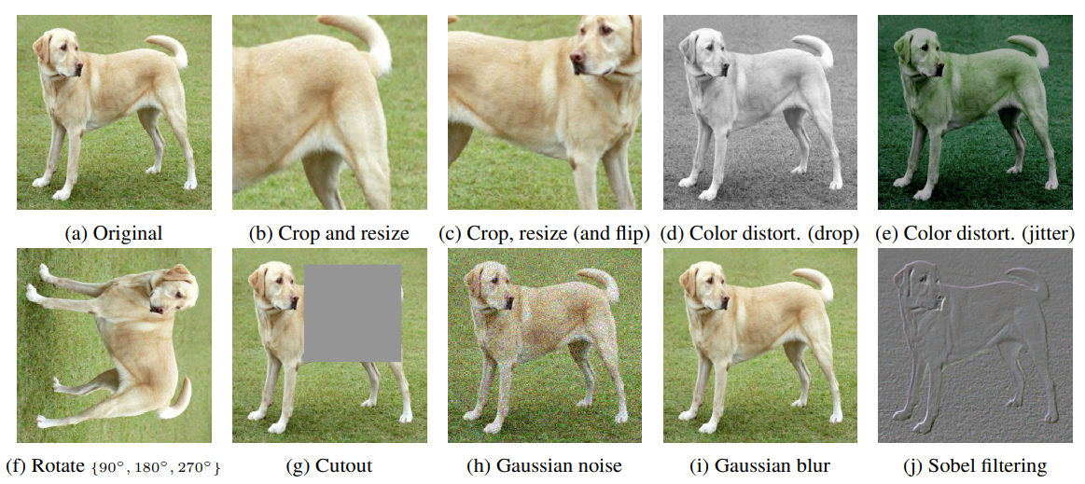
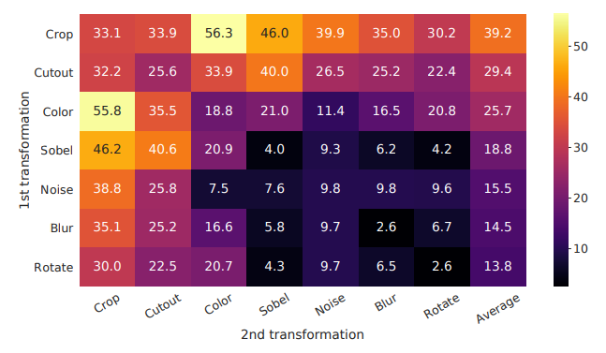
Background: SimCLR
Data augmentation: crop & color distortion

Slide 6
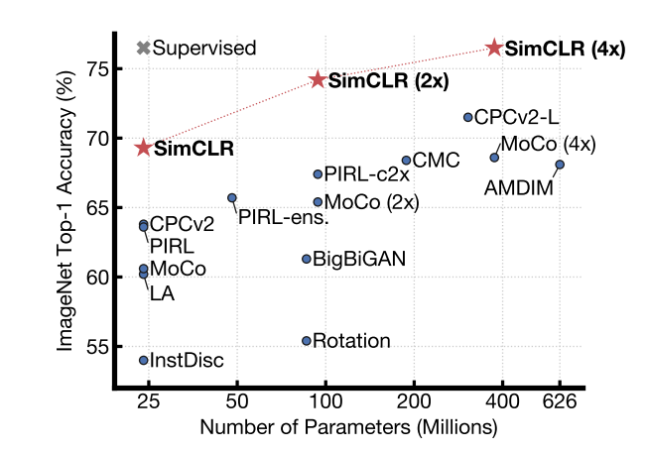
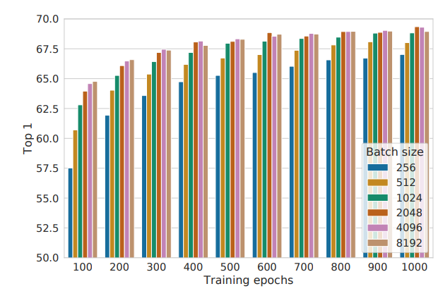
Background: SimCLR
Results for linear evaluation on ImageNet
Top-1 accuracy

Slide 7
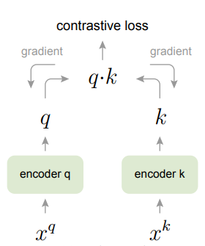
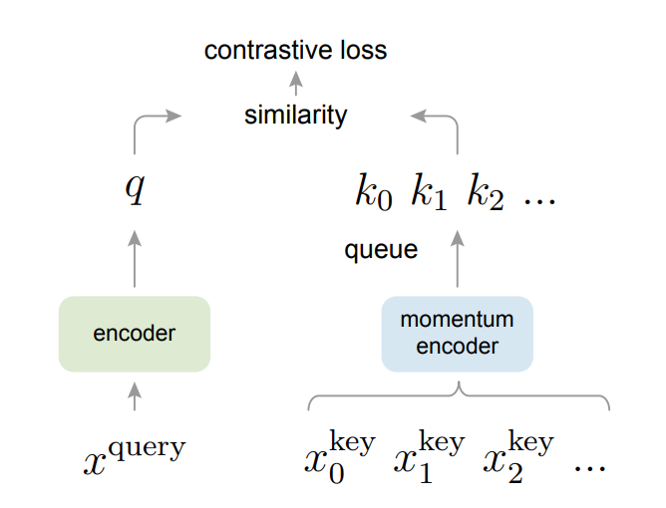
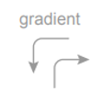
Background: MOCO
Contrastive learning with dictionary
Momentum encoder

Slide 8
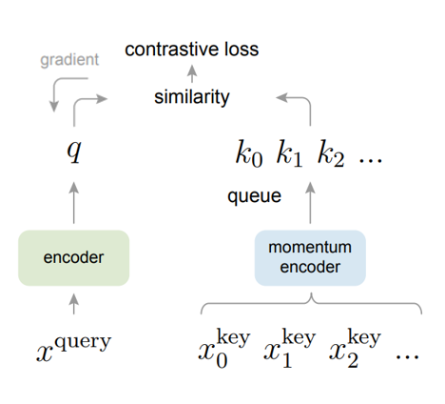
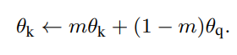
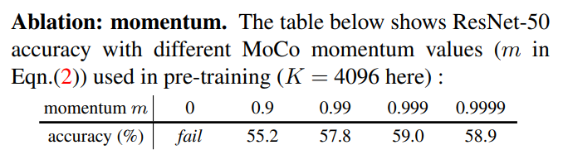
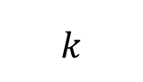
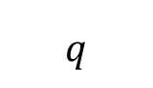
Background: MOCO
Contrastive learning with dictionary
Momentum encoder: $m=0.999$
$$q$$
$$k$$

Slide 9
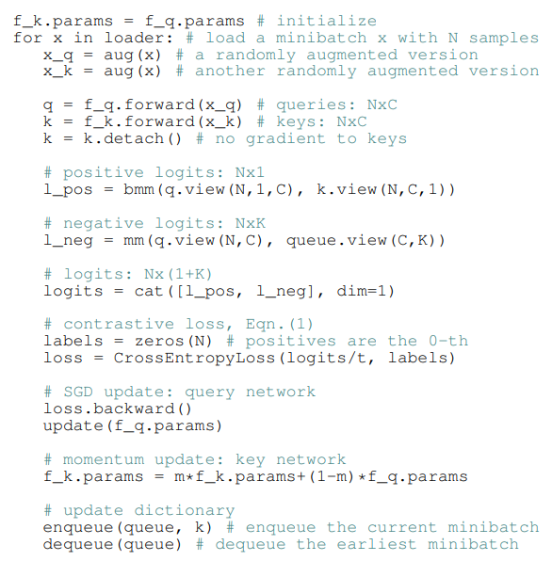
Background: MOCO
Contrastive learning with dictionary
Momentum encoder: $m=0.999$
$$q$$
$$k$$

Slide 10
Method: DINO
Self-supervised learning without contrastive learning
Knowledge distillation
Motivation
In NLP, transformer architecture has been successful because of self-supervised learning (pretext task)
E.g., next sentence prediction and masked language model in BERT
next token prediction in GPT
In this paper, tried to apply effective self-supervised learning while focusing on ViT

Slide 11
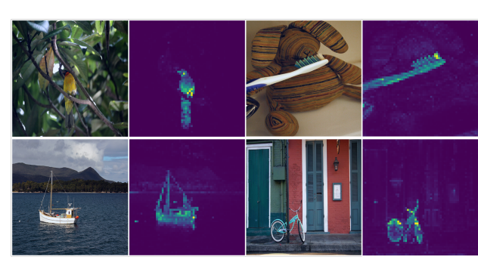
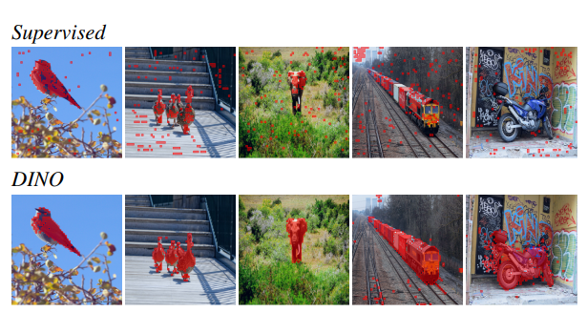
Method: DINO
Self-supervised ViT feature has explicit semantic segmentation of input image

Slide 12
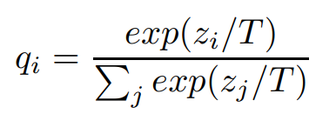
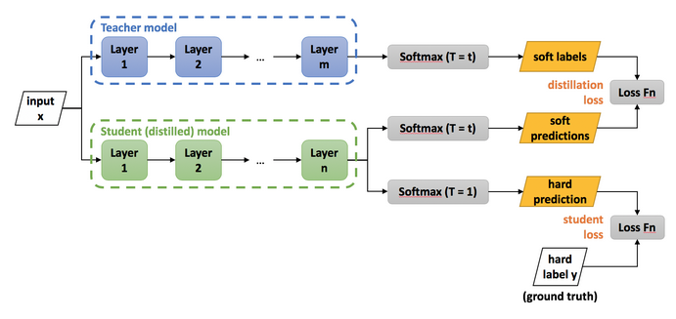
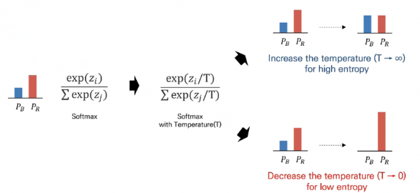
Method: DINO
Training process
Data augmentation
Knowledge distillation

Slide 13
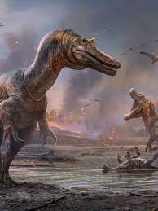
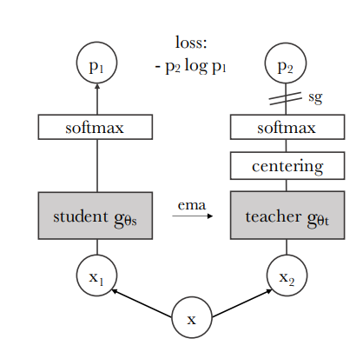
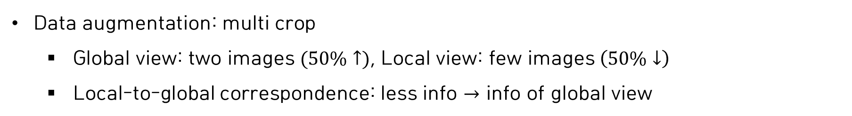
Method: DINO
Data augmentation: multi crop
Global view: two images $(50\%↑)$, Local view: few images $\left(50\%↓\right)$
Local-to-global correspondence: less info $→$ info of global view

Slide 14
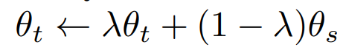
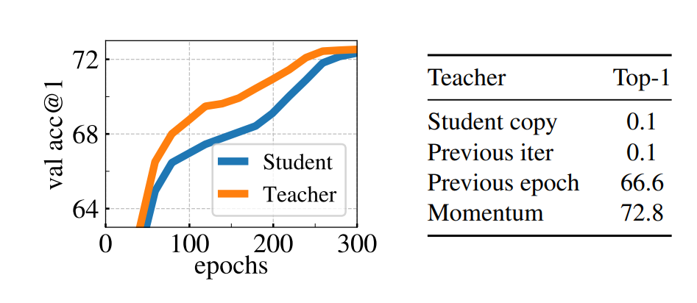
Method: DINO
Self-distillation: learn teacher’s knowledge
Momentum update: $0.996≤ λ≤ 1$
Top-1 accuracy on ImageNet with k-NN classifier

Slide 15

Method: DINO

Slide 16

Method: DINO
Centering & sharpening
Prevents collapse (dominate collapse, uniform collapse)
Collapse: Same output regardless of input

Slide 17
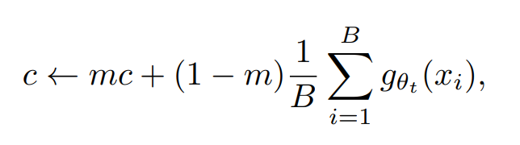



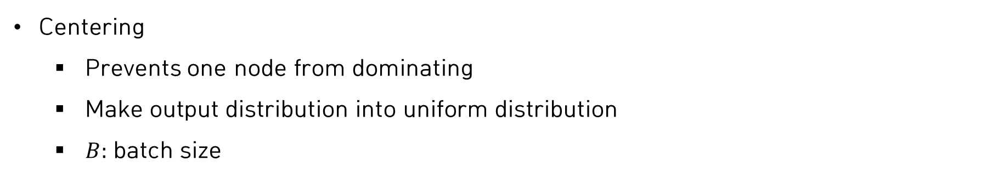

Method: DINO
Centering
Prevents one node from dominating
Make output distribution into uniform distribution
$B:$ batch size
$$μ=−100$$
centering
$$μ=0$$
$$μ=0$$
$$μ=100$$

Slide 18
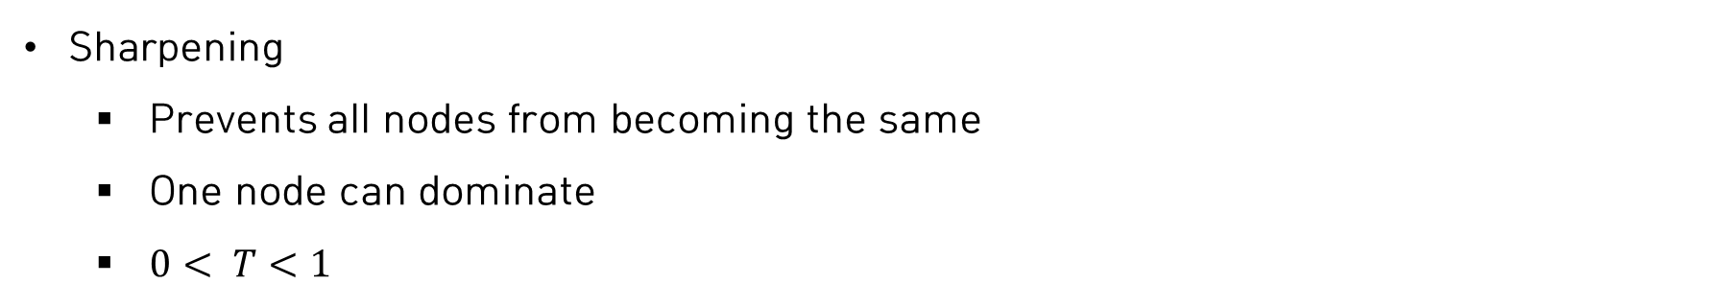
Method: DINO
Sharpening
Prevents all nodes from becoming the same
One node can dominate
$0< T<1$

Slide 19
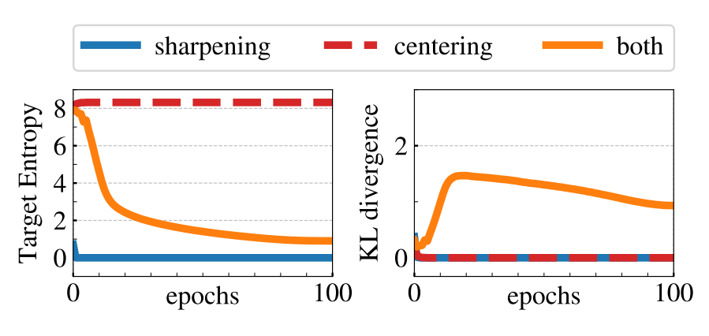
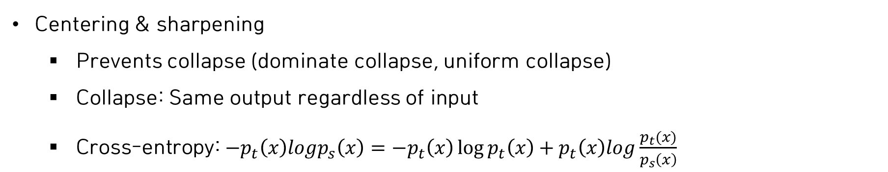
Method: DINO
Centering & sharpening
Prevents collapse (dominate collapse, uniform collapse)
Collapse: Same output regardless of input
Cross-entropy: $−p_{t}\left(x\right)logp_{s}\left(x\right)=−p_{t}\left(x\right)\log{p_{t}\left(x\right)+p_{t}\left(x\right)log\frac{p_{t}(x)}{p_{s}\left(x\right)} }$
KL divergence between teacher and student outputs
Teacher’s target entropy
Teacher’s target entropy & KL divergence between teacher and student outputs

Slide 20
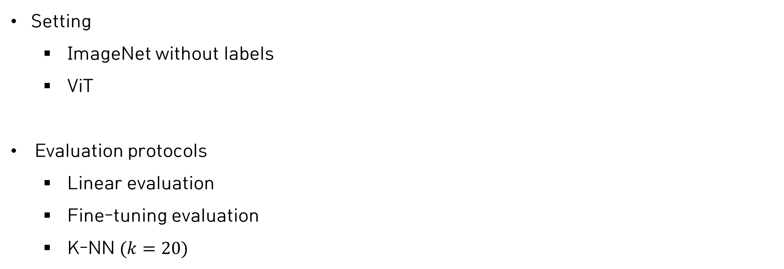
Experiments
Setting
ImageNet without labels
ViT
Evaluation protocols
Linear evaluation
Fine-tuning evaluation
K-NN $(k=20)$

Slide 21
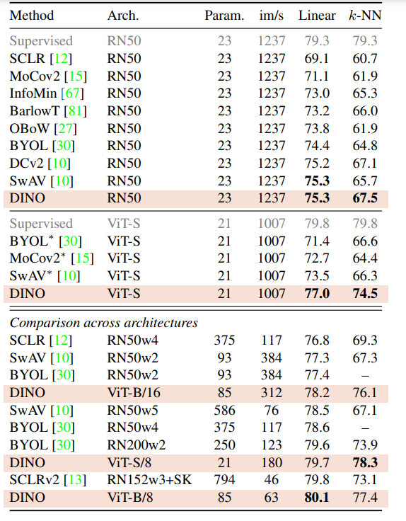
Experiments
Linear & K-NN classification on ImageNet
Smaller patch is effective (8 vs 16)
ResNet
ViT

Slide 22
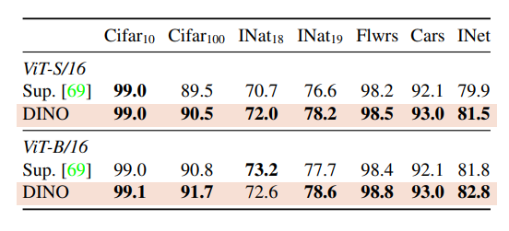
Experiments
Transfer learning by Fine-tuning pretrained models on different datasets

Slide 23
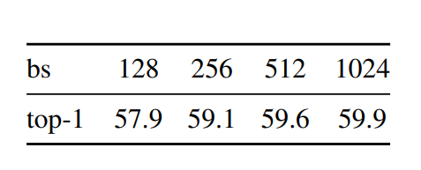
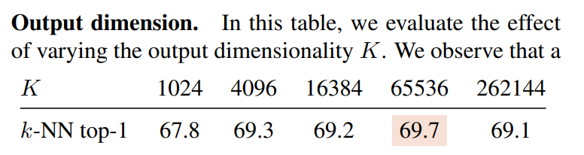
Experiments
Batch size & output dimension

